Slide 1
DVB-S2X & RCS2
System Architecture for NTN NR Integration

Slide 2
Contents:
System Architecture of DVB E2E System
Protocol Stack For DVB-S2X and DVB-RCS2
L1 Frame Structure (Baseband Frames, PL Frames, Framing Details)
Logical and Physical Channels (Forward and Return Links)
How To: Implement NTN NR On Top Of DVB L1.

Slide 3
DVB-S2X & RCS2
System Architecture of DVB E2E System

Slide 4
Overview of DVB-S2X (Forward Link)
DVB-S2X = enhanced version of DVB-S2 (mainly used for broadcast & forward links)
Provides high spectral efficiency (supports high-order modulations like 64APSK)
Common in satellite broadband, digital TV, and VSAT forward links
Notes:
DVB-S2X is used to send data from the satellite gateway to the users. It’s highly optimized with features like variable coding, MODCODs, and flexible framing structures. The forward link is often one-way, but optimized for capacity and reliability.

Slide 5
Overview of DVB-RCS2 (Return Link)
DVB-RCS2 = return channel via satellite (for interactive services)
Handles uplink from user terminals (RCSTs) to the gateway/NCC
Uses advanced MAC scheduling, demand assignment, and time slicing
Notes:
This is the uplink path, where user terminals (like homes, ships, or ground stations) send data back to the satellite, then down to the gateway. It’s more complex due to shared channel access – terminals must be coordinated to avoid collisions.

Slide 6
System Components: DVB-S2X
Gateway: Takes IP traffic, forms BBFRAMEs
BBFRAME: Baseband frame with payload + headers
FEC: LDPC + BCH encoding (error correction)
MODCOD: Modulation + Coding Scheme (e.g., 32APSK + 5/6)
PLFRAME: Physical Layer Frame sent over the air
Notes:
Each step wraps and protects the data. BBFRAME is like a container, FEC protects it from errors, MODCOD decides efficiency vs. robustness, and PLFRAME is what’s physically transmitted via satellite.

Slide 7
System Components: DVB-RCS2
RCST: Return Channel Satellite Terminal (user device)
MAC: Controls when/how to send (TDMA, demand-assigned)
Scheduler/NCC: Coordinates multiple users to avoid conflict
Return Carriers: Time slots assigned for each terminal
Notes:
In the uplink, the terminal must wait for permission/schedule to transmit. Think of it like a shared classroom – only one can speak at a time. This ensures the satellite doesn’t receive overlapping signals.

Slide 8
Forward Link Architecture (DVB-S2X)
Optimized for high throughput
Used for video, internet downlink, software updates
Terminals are usually receive-only in this path
Data goes through several processing stages at the gateway before being uplinked. The satellite mostly acts as a transparent repeater. The terminal demodulates and decodes the PLFRAME back into usable IP packets.
Notes:
To show how data is processed before being transmitted to the satellite, focusing on DVB-S2X uplink side.
Gateway = The entry point of the signal chain — data originates here. Think of it as the transmitter on Earth.
BBFRAME = "Baseband Frame" — This wraps the actual payload (data) with necessary headers. Like putting your letter in an envelope.
FEC (LDPC + BCH) = Adds error correction codes using LDPC (main) and BCH (outer) codes. Helps recover lost/corrupted data at receiver.
MODCOD = Combines modulation (e.g., QPSK, 8PSK, 16APSK) and coding rate (e.g., 3/4). Optimizes bandwidth & reliability.
PLFRAME = "Physical Layer Frame" — packages all above into a standardized unit for modulation.
Satellite (Relay) = Satellite just forwards the signal — it does not decode, just retransmits to the other side (user terminal).
🧠 Analogy:
Like a letter going through:
Written → 2. Put in envelope → 3. Sealed → 4. Assigned postage → 5. Put in a box → 6. Shipped 🚚

Slide 9
Return Link Architecture (DVB-RCS2)
Used for control messages, interactive apps, telemetry
Controlled by a central scheduler (NCC)
Uplink is time-shared using TDMA
The terminal gets assigned time slots to transmit. It packages data into bursts, transmits, and the satellite relays it back to the ground hub. This ensures the system scales with many users.

Slide 10
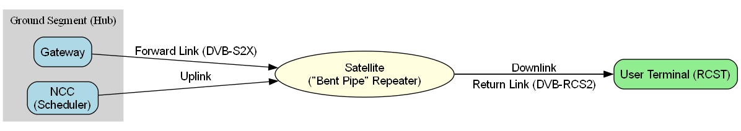
Combined DVB System Architecture
Full duplex system via separate forward and return links
DVB-S2X handles downlink; DVB-RCS2 handles uplink
Enables interactive satellite broadband
Now we see the whole communication loop: The gateway sends data, and the terminal responds. The satellite acts as a passive “mirror” (bent pipe), and most logic happens on the ground.
Notes:
✅ Purpose of this Slide:
To clearly show how:
DVB-S2X is used for downlink/forward transmission (from Gateway to User Terminal),
DVB-RCS2 is used for uplink/return transmission (from User Terminal back to Gateway),
Both operate via a “bent pipe” satellite, which just forwards signals without decoding.

Slide 11
Key Takeaways
DVB-S2X: Efficient forward link, BBFRAME to PLFRAME
DVB-RCS2: Flexible return link, MAC-managed
Together they form a complete two-way SATCOM system
This architecture lays the groundwork for NTN NR over DVB L1
Explanation:Understanding this foundation is crucial. Later, we’ll explore how to map NR layers over this system — identifying what can be reused (like PHY or scheduling) and what needs redesign.

Slide 12
DVB-S2X & RCS2
  Protocol Stack For DVB-S2X and DVB-RCS2

Slide 13
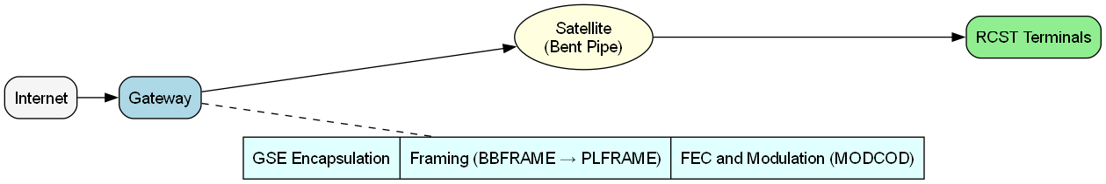
DVB-S2X System Overview (Forward Link)
Internet traffic enters the Gateway.
Gateway performs:
  GSE encapsulation
  Framing (BBFRAME → PLFRAME)
  FEC and Modulation (MODCOD selection)
Satellite acts as a bent pipe (just relays the signal).
RCST receives and demodulates frames using the info in PLS Header.

Slide 14
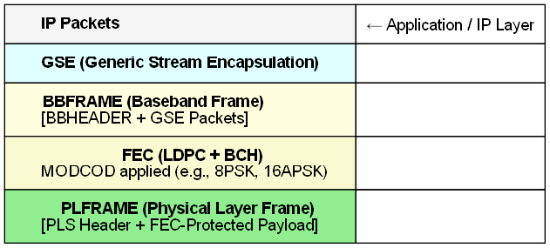
DVB-S2X Forward Link Protocol Stack
IP Layer: Entry point; normal internet packets (e.g., video, HTTP).
GSE Layer: Packs IP packets into a lightweight, flexible DVB-friendly format.
BBFRAME: Combines multiple GSE packets + adds Baseband Header (for sync, type, etc.).
FEC Layer: Applies powerful LDPC (main) + BCH (outer) codes for error protection.
PLFRAME: The final physical frame. Contains:
  PLS Header: tells receiver what MODCOD was used
  Payload: FEC-protected BBFRAME
  Pilot Symbols (for synchronization)

Slide 15
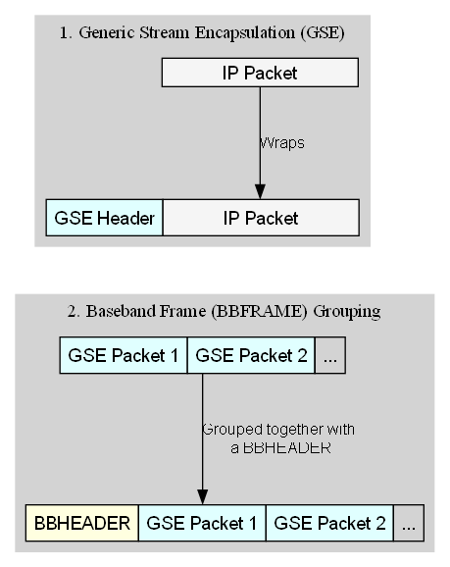
Encapsulation – GSE & Baseband Frame (BBFRAME)
Generic Stream Encapsulation (GSE)
GSE is the convergence layer that wraps IP packets into a flexible, lightweight format.
Designed for efficient transport of variable-length packets, like IP or Ethernet.
Each GSE packet includes:
  GSE header (Type, Length, Flags)
  One IP packet (payload)
Baseband Frame (BBFRAME)
Multiple GSE packets are grouped together into a BBFRAME.
A BBHEADER is added to the front of the frame:
  Sync, Frame Type, Length
  Input Stream ID (to help identify services)
BBFRAME is the basic data unit passed into the physical layer.

Slide 16
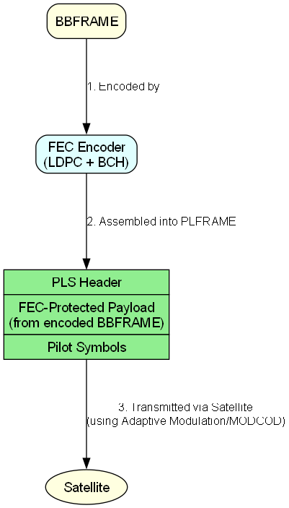
Physical Layer Framing – FEC & PLFRAME
Forward Error Correction (FEC)
DVB-S2X uses a two-stage FEC system:
  LDPC (Low-Density Parity-Check) → main, powerful FEC code
  BCH (Bose–Chaudhuri–Hocquenghem) → error detection & outer cleanup
This combo allows reliable decoding even under weak satellite signal (rain fade, noise)
Adaptive Coding & Modulation (ACM)
Each PLFRAME uses a specific MODCOD (e.g., QPSK, 8PSK, 16APSK, 32APSK)
  Selected dynamically at the Gateway based on:
  Terminal link quality
  Weather
  SNR reports from RCST
Better link = higher modulation = higher throughput
PLFRAME (Physical Layer Frame)
Final encapsulated unit transmitted over the air
Contains:
  PLS Header (tells the receiver what MODCOD is used)
  FEC-protected payload (the encoded BBFRAME)
  Pilot Symbols (for timing/sync/channel estimation)

Slide 17
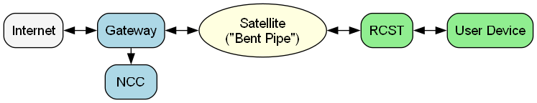
DVB-RCS2 System Overview
DVB-RCS2 (Digital Video Broadcasting – Return Channel via Satellite, 2nd generation) is designed to support interactive satellite communication, especially from users back to the internet.
In DVB-RCS2 systems, users send and receive data through an RCST, relayed by a transparent satellite, while the gateway and NCC manage the network’s control and scheduling functions.
Notes:
Introduce the main components of the DVB-RCS2 system and show how data flows in the forward and return links via satellite. This sets the groundwork for understanding how terminals, gateways, and the satellite interact.
1. RCST (Remote Control Satellite Terminal)
The user terminal at the edge (e.g., a satellite dish on the customer side).
It receives data from the Forward Link (DVB-S2X) and sends data on the Return Link (DVB-RCS2).
It does not transmit freely — it must request access from the network.
2. Satellite (Transparent/Bent-Pipe)
A relay between ground segments (no onboard data processing).
Just amplifies and redirects signals:
Forward Link: Gateway → Satellite → RCST
Return Link: RCST → Satellite → Gateway
3. Gateway (Hub Station)
Connects the satellite system to the terrestrial network (e.g., internet).
Sends user data and control messages on the Forward Link.
Receives bursts from RCSTs on the Return Link.
Demodulates and routes them into the internet.
4. NCC (Network Control Center)
Responsible for network management, resource allocation, and burst scheduling.
Sends timing plans, burst profiles, and Terminal Parameter Groups (TPGs) via the Forward Link.
Works alongside the Gateway but logically can be a separate entity.

Slide 18
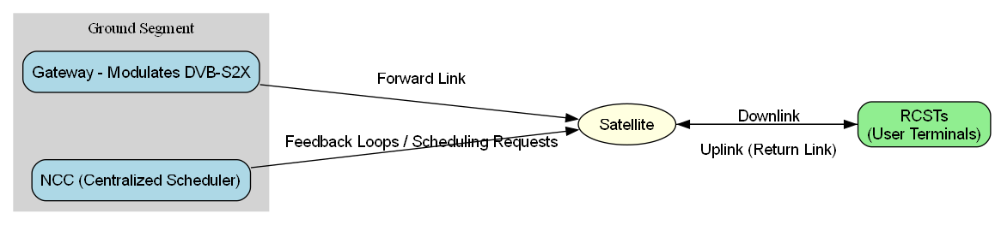
Gateway and NCC responsibilities.
Gateway: Interface to terrestrial network, modulates DVB-S2X
NCC: Centralized scheduler, generates terminal parameter groups (TPGs), burst profiles, timeslot plans
Manages access types (CRA, DAMA, VBDC, etc.)
Notes:
🛰 Return Link Dynamics:
RCSTs don’t transmit freely — they must request bandwidth first.
RCSTs send Scheduling Requests (SR) to the NCC via a Contention-based Access (CRA) or Dedicated Control Slots.
🧠 NCC’s Role:
The NCC (Network Control Center) is the centralized scheduler.
It collects:
Traffic demand from RCSTs (e.g., data queues, QoS class).
Channel conditions and terminal status.
Then, it computes a TDMA (Time Division Multiple Access) frame schedule, assigning slots per RCST.
The frame is broadcast back to all RCSTs via the DVB-S2X forward link from the Gateway.
🧭 Gateway’s Role:
Acts as the modulator of the DVB-S2X forward link.
Transmits data + signaling frames (burst profiles, slot allocation tables).
🔁 Feedback Loop:
RCSTs adapt their transmission behavior based on NCC’s commands.
Helps optimize bandwidth, reduce collisions, and meet QoS targets.
🧩 Add this optional explanation box:
“In DVB-RCS2, RCSTs do not control their uplink independently. They rely on a centralized scheduler (NCC), which dynamically allocates time slots and adjusts traffic priorities to optimize satellite link utilization.”
Summary Sentence (bottom of slide):
“DVB-RCS2 return link relies on a centrally coordinated TDMA system, with intelligent scheduling by the NCC and real-time feedback from RCSTs.”

Slide 19
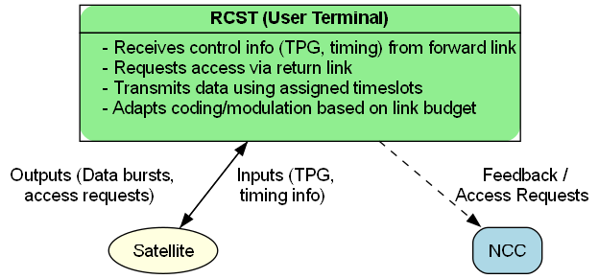
RCST (User Terminal) Functions
Notes:
🧠 Explanation Breakdown for the Slide:
🟩 RCST Capabilities:
Receives Control Info: RCST gets Timing & TPG (Terminal Parameter Group) instructions via the forward link (from the Gateway).
Requests Access: Before sending data, the RCST must request uplink slots from the NCC.
Transmits in Assigned Slots: After receiving permission, it transmits bursts in the scheduled TDMA slots.
Adapts Modulation/Coding: Based on current link budget (signal quality, path loss, etc.), RCST adapts its physical layer parameters to maintain optimal performance.
🔄 Communication Flows:
To Satellite: RCST sends both data bursts and access requests.
From Satellite: It receives TPG and timing data, allowing synchronization with the TDMA schedule.
To NCC: RCST gives feedback, including demand and performance metrics.
🔁 Adaptive Access:
DVB-RCS2 uses Adaptive Coding and Modulation (ACM) not only on forward links (DVB-S2X), but also on return links.
RCST dynamically adjusts its transmission to optimize throughput, avoid congestion, and fit the shared medium.
🧩 Optional Box (Bottom of Slide):
"RCSTs are not passive receivers — they actively participate in the return link scheduling process, adapt to changing channel conditions, and optimize the use of shared satellite resources."
Final Summary:
"DVB-RCS2 empowers user terminals (RCSTs) with intelligence: they request access, adapt transmission strategies, and maintain synchronized communication with the gateway and NCC."

Slide 20
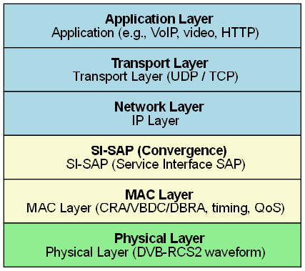
DVB-RCS2 Return Link Protocol Stack
The return link (from RCST to hub) in DVB-RCS2 follows a layered protocol stack, similar to the OSI model.
SI-SAP (Service Interface SAP) acts as a convergence layer that adapts IP traffic into satellite-compatible frames.
The MAC Layer handles scheduling, access types (CRA, VBDC, DBRA), and QoS enforcement.
The Physical Layer implements burst transmission based on the DVB-RCS2 waveform.
Notes:
DVB-RCS2 defines a layered protocol stack to structure communication from the user terminal (RCST) to the gateway. At the top, user applications like VoIP, video streaming, or file transfer generate IP packets. These traverse the standard transport (TCP/UDP) and network (IP) layers before being passed to SI-SAP, which handles convergence and encapsulation.
The MAC layer is responsible for access control, timeslot scheduling, and QoS classification. It determines when and how a terminal can transmit. Finally, the physical layer transmits data bursts over the return link using modulated RF waveforms.

Slide 21
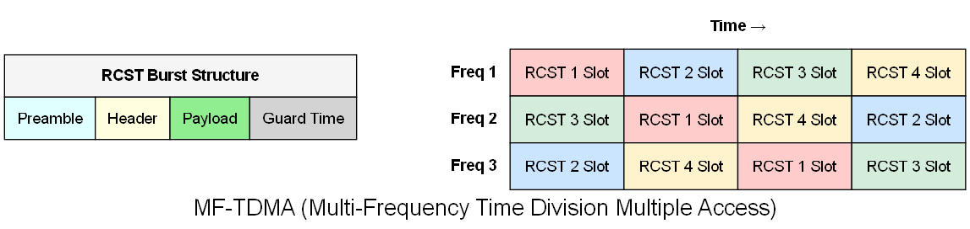
Physical Layer: DVB-RCS2 Return Link Transmission
DVB-RCS2 uses MF-TDMA for return link transmissions.
Data from RCSTs is sent in bursts, each occupying a time slot within a specific frequency channel.
Burst structure includes:
  Preamble: for synchronization
  Header: with signaling/meta info
  Payload: actual user data
  Guard Time: to prevent overlap between burst
  Supports adaptive modulation and coding (ACM) to adjust to link conditions (e.g., QPSK, 8PSK, 16QAM).
Notes:
Explanation:
Burst Structure (Left Diagram):
Each RCST (user terminal) sends a burst on the return link that follows a structured format:
Preamble: Used for synchronization.
Header: Contains burst control and addressing info.
Payload: Actual user data being sent.
Guard Time: Prevents overlapping between bursts due to propagation delay.
MF-TDMA (Right Diagram):
Return link uses Multi-Frequency Time Division Multiple Access (MF-TDMA).
Multiple RCSTs can transmit simultaneously on different frequencies and different time slots.
Efficient way to share bandwidth dynamically among many terminals.
This is orchestrated by the NCC scheduler, which assigns slots to RCSTs based on demand and traffic.

Slide 22
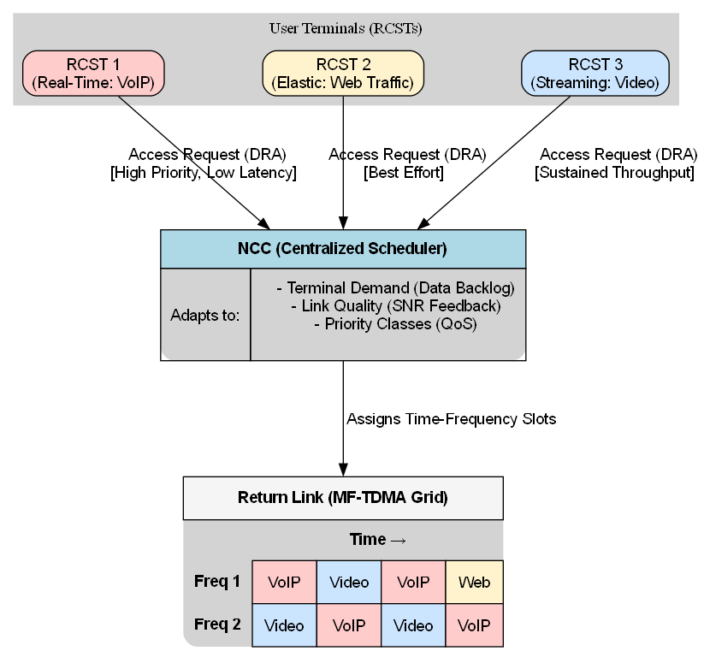
QoS and Scheduling in DVB-RCS2 Return Link
DVB-RCS2 uses centralized scheduling managed by the NCC to ensure Quality of Service (QoS) through dynamic return link allocation.
Centralized Scheduler (NCC) assigns time-frequency slots per terminal dynamically.
Return Link Scheduling adapts to:
  Terminal demand (data backlog)
  Link quality (channel condition feedback)
  Priority classes / QoS levels
QoS Classes:
  Real-Time (e.g., VoIP): low latency guaranteed
  Elastic (e.g., web traffic): best effort
  Streaming/Video: moderate delay, sustained throughput
RCSTs request slots using DRA (Dynamic Resource Allocation) via access requests in control bursts.
Notes:
User terminals request return link access via Dynamic Resource Allocation (DRA), prioritizing traffic based on Quality of Service (QoS) class. The NCC scheduler adapts dynamically and assigns MF-TDMA slots accordingly.

Slide 23
DVB-S2X & RCS2
Layer 1 (L1) Framing in DVB Systems

Slide 24
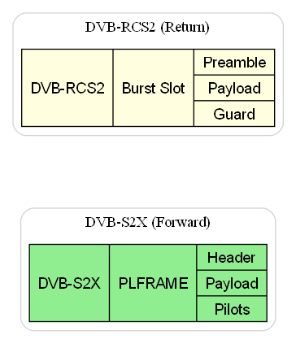
Intro to L1 Framing (DVB-S2X & RCS2)
What is L1 Framing?
Layer 1 (Physical Layer) is responsible for converting digital data into modulated signals for satellite transmission.
It wraps baseband data into structured frames with:
  Signaling info (headers)
  Error protection (FEC)
  Synchronization aids (pilot symbols, preambles)
Forward and return links use different framing methods:
  S2X: Continuous PLFRAMEs with powerful FEC + ACM
  RCS2: MF-TDMA bursts inside time-frequency slots

Slide 25
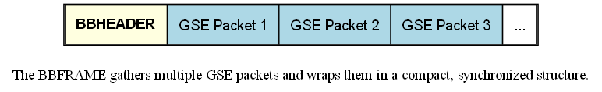
Baseband Frame (BBFRAME) Structure
A Baseband Frame is the data container that holds multiple GSE packets (from the convergence layer).
It is the input to the physical layer for error protection and modulation.
Each BBFRAME is uniform in size (typically ~64K bits) to make signal processing predictable.
Structure:
BBHEADER
  This is like a “label” stuck at the front of the frame.
  Contains:
    Stream type (is this video? IP data?)
    Length
    Sync info (helps the receiver align the bits)
Payload
  Made up of one or more GSE packets
  These carry the actual user data (like IP packets, video chunks, etc.)

Slide 26
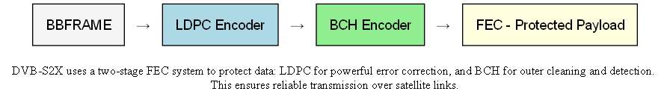
Forward Error Correction: LDPC + BCH
LDPC (Low-Density Parity-Check) “A smart net that catches most errors.”
Main error correction code.
Adds redundancy in a clever, sparse matrix pattern that makes decoding efficient.
Excellent for correcting many errors with low overhead.
BCH (Bose–Chaudhuri–Hocquenghem) “A final quality check at the door.”
Outer error correction layer.
Adds a second line of defense to clean up any errors LDPC couldn’t fix.
Also helps in detecting uncorrectable errors.
Notes:
To explain how DVB-S2X protects the BBFRAME from data corruption using two layers of error correction, before it becomes a PLFRAME.

Slide 27
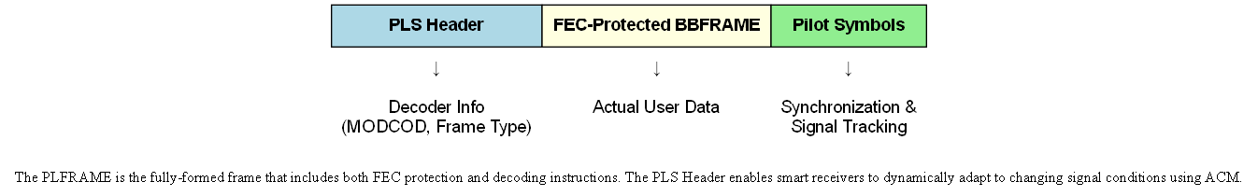
PLFRAME Composition & PLS Header
What Does the PLS Header Do?
Think of it as a map or instruction sheet for the receiver.
It tells the receiver how to decode and demodulate the incoming signal.
Contains:
  MODCOD info (what modulation + FEC to use: QPSK, 8PSK, 16APSK, etc.)
  Frame type (short or normal)
  Stream ID or frame count info
Without the PLS Header, the receiver wouldn’t know how to begin decoding.
What Are Pilot Symbols?
Known, fixed patterns inserted at regular intervals.
Help the receiver lock on to the signal (like adjusting a radio tuner).
Used for:
  Timing recovery
  Channel estimation
  Frequency synchronization
Notes:
To explain what the Physical Layer Frame (PLFRAME) looks like, and the critical role of the PLS Header in helping the receiver interpret the frame.
🔹 What is a PLFRAME?
The final data frame transmitted over the air by the satellite system.
It contains:
A PLS Header (Physical Layer Signaling Header)
A payload (which is the FEC-protected BBFRAME)
Pilot Symbols for signal tracking and synchronization

Slide 28
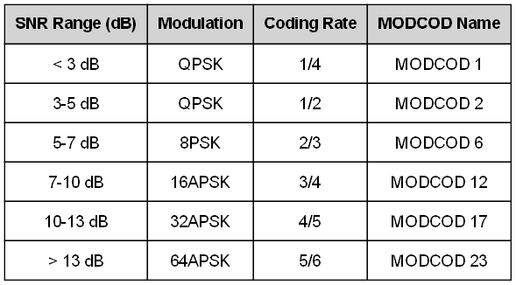
MODCOD Mapping & ACM in DVB-S2X
What is MODCOD?
MODCOD = Modulation + Coding
It's a combo of:
  Modulation type (QPSK, 8PSK, 16APSK, 32APSK, 64APSK)
  Coding rate (e.g. 1/2, 3/4, 5/6 – how much redundancy is used)
How MODCOD is Selected:
The Gateway monitors each user’s SNR (Signal-to-Noise Ratio).
Based on the SNR, it picks the best MODCOD that:
  Maximizes throughput
  Maintains reliable reception
Higher SNR → more efficient MODCOD
Lower SNR → robust but slower MODCOD
Notes:
To show how the gateway dynamically chooses the best modulation & coding rate (MODCOD) for each user — based on link quality like SNR.
✅ What is ACM?
ACM = Adaptive Coding and Modulation
It's a smart technique used in satellite communication systems (like DVB-S2X) that automatically adjusts:
🌀 Modulation type (QPSK, 8PSK, 16APSK, etc.)
🧩 Coding rate (how much error protection is added)
…based on real-time link quality (mainly SNR – signal-to-noise ratio).
🧠 Simple Analogy:
Imagine you're on a video call while walking around:
In a quiet room with strong Wi-Fi, your call is HD quality — high throughput.
But when you're in an elevator with bad signal, your phone automatically lowers the video quality — less data, but more reliable.
That’s ACM in action, but for satellite links.
🛰️ In DVB-S2X:
The gateway (hub) monitors how good each user’s satellite signal is.
For strong signals, it sends more data using faster modulations (e.g., 32APSK, 64APSK) and less redundancy.
For weak signals (like rain fade), it switches to simpler modulations (e.g., QPSK) with stronger error correction.
This helps:
📈 Maximize throughput
✅ Maintain reliability
⚡ Avoid wasting bandwidth

Slide 29
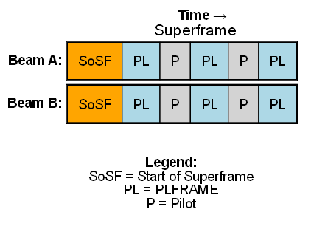
Superframe Structure
A Superframe is a structured sequence of PLFRAMEs used for efficient and synchronized transmission across beams.
It begins with a Start of Superframe (SoSF) marker to help terminals lock onto timing.
Pilot symbols (P) are inserted between frames to aid channel estimation and demodulation.
This structure ensures all beams (e.g., Beam A and B) stay aligned, which is essential for techniques like precoding and multi-beam coordination.
Notes:
🎯 Purpose of This Slide:
To explain how DVB-S2X organizes multiple PLFRAMEs into a larger, synchronized Superframe — enabling beam hopping, terminal synchronization, and carrier coordination, especially for advanced systems like HTS and NGSO.
🔸 What is a Superframe?
A Superframe is a larger framing unit composed of:
A Start of Superframe (SoSF) marker
Multiple PLFRAMEs
Periodic Pilot blocks
Optional Bundled PLFRAMEs
It has a fixed duration (e.g., 1s or 250ms depending on system design)
All beams and carriers are aligned to the same superframe clock
Why Superframes Matter:
Synchronization = Helps terminals lock onto the carrier timing
Beam Hopping = Ensures terminals know when their beam is active
Multi-Beam Systems = Aligns timing across beams to reduce interference
Channel Bonding = Enables combining multiple carriers to one superframe
🔹 Advanced Framing Features:
Bundled PLFRAMEs → Reduces signaling overhead by grouping frames
Pilot Structures → Provide timing, frequency, and phase reference
SoSF Marker → Uniquely identifies the start of each superframe
DVB-S2X Superframes bring timing structure and alignment across carriers and beams, enabling precise synchronization and efficient resource scheduling in modern satellite systems.

Slide 30
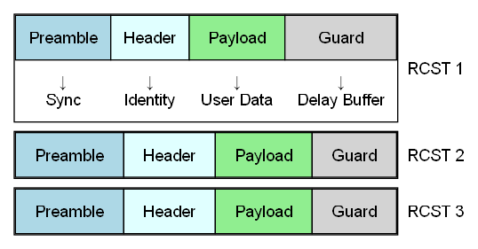
Return Link Burst Framing (MF-TDMA in DVB-RCS2)
Multi-Frequency Time Division Multiple Access
A sharing method that allows many user terminals (RCSTs) to take turns sending data on different time slots and frequencies.
Like a schedule of parking spots:
  Each user gets a “slot” to send their burst
  At a set time
  On a specific frequency
Notes:
🎯 Purpose of This Slide:
Introduce how data is framed and transmitted from the user (RCST) back to the gateway, using MF-TDMA bursts.
This is where time and frequency slots are assigned to multiple users to avoid collisions.
Burst = Framed Data from RCST
Each burst contains:
Preamble
Helps the satellite detect and sync with the signal
Similar to a “knock on the door”
Header
Identifies the sender
Indicates burst type (data, control)
Payload
The actual user data
Guard Time
A small pause added after the burst to avoid overlapping with others (compensates for propagation delay)

Slide 31
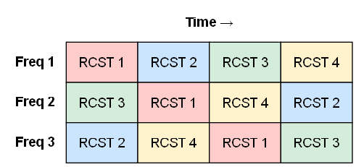
MF-TDMA Burst Grid in Return Link (DVB-RCS2)
What is the Burst Grid?
The return link uses MF-TDMA:
Multi-Frequency Time Division Multiple Access.
Think of it like a grid of parking slots —
where each row is a frequency
and each column is a time slot.
The scheduler assigns these slots to different users (RCSTs) based on:
  Demand (who wants to send data)
  QoS class (VoIP gets priority)
  Link conditions
Notes:
🔄 Dynamic Scheduling
The NCC (Network Control Center) sends instructions to RCSTs telling:
Which frequency to use
At what time
For how long
With which modulation (MODCOD)
In DVB-RCS2, return link capacity is divided into a time-frequency grid, enabling many RCSTs to share bandwidth efficiently. The NCC dynamically allocates these bursts to match traffic demand and QoS requirements.

Slide 32
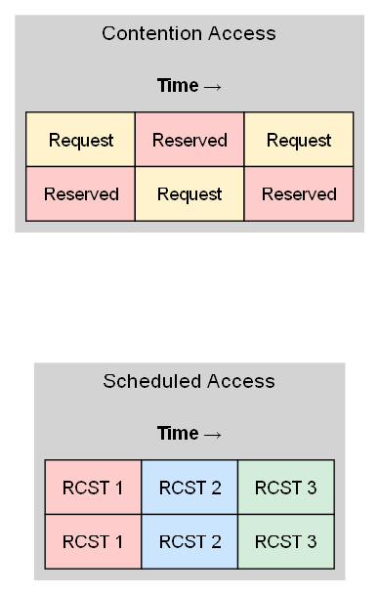
Slot Assignment Strategy in DVB-RCS2
Contention-Based Assignment
Used when the RCST has no current reservation.
Terminal sends a bandwidth request burst in shared slots.
Multiple users might try to access the same slot.
Risk of collision — handled by:
  Backoff timers
  Retransmissions
Similar to Wi-Fi access — "ask first, retry if busy“
Scheduled Assignment
Used when the RCST already has a bandwidth reservation.
The NCC (Network Control Center) pre-allocates specific slots to an RCST.
Based on:
Traffic demand, QoS class (e.g., VoIP, file transfer, streaming), Terminal priority
Ensures predictable access — like a reserved lane on a highway.
Notes:
🎯 Purpose of This Slide:
To explain how the network decides which RCST gets which time-frequency slots, and the two main methods of assignment:
Scheduled (reservation-based)
Contention-based (requesting slots)
🔁 How the Scheduler Works:
The NCC scheduler constantly updates assignments.
RCSTs receive updates via forward link control messages.
Dynamic allocation adapts to:
Congestion
Traffic load
Terminal conditions
DVB-RCS2 uses a flexible slot assignment model: reserved slots for guaranteed delivery, and contention-based access for best-effort data. The NCC dynamically balances both to optimize return link performance.

Slide 33
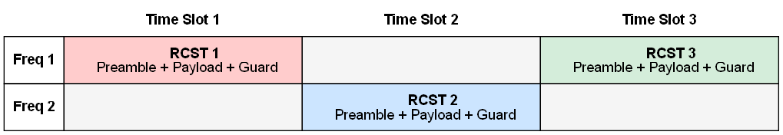
RCST Return Burst Timing
Return bursts are short, time-slotted transmissions from RCSTs to the gateway.
Each RCST is assigned a specific time-frequency slot by the NCC (Network Control Center).
The burst timing must be extremely accurate to fit inside the guard interval and avoid overlap with adjacent slots.
Return bursts typically include:
  Preamble (for synchronization)
  Payload (user data)
  Guard time (to prevent collisions due to delay variations)
Notes:
This slide explains how user terminals (RCSTs) transmit return bursts in precisely timed windows within the MF-TDMA grid. Accurate burst timing ensures no collisions and efficient spectrum usage.

Slide 34
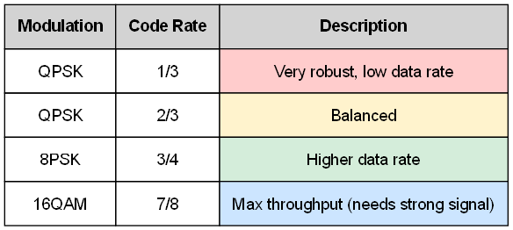
RCS2 Modulation & Coding
Notes:
📄 Slide Content (Text):
🔹 What is MODCOD?
MODCOD = Modulation + FEC Coding Scheme
Each RCST uses a MODCOD configuration to transmit data with the best balance between throughput and robustness.
🔹 Modulation Types Used in RCS2:
QPSK – Highly robust, used in poor link conditions
8PSK, 16QAM, 32QAM – Higher throughput, used in good link conditions
🔹 Coding Schemes:
Uses Turbo Coding for Return Link
Code rates (examples): 1/3, 1/2, 2/3, 3/4
Higher code rate → less redundancy → higher throughput, but needs better signal quality
🔹 Adaptive Coding & Modulation (ACM):
Optional in return link, depending on system setup
RCST can be assigned MODCODs based on:
Channel quality
Terminal capability
Traffic priority

Slide 35
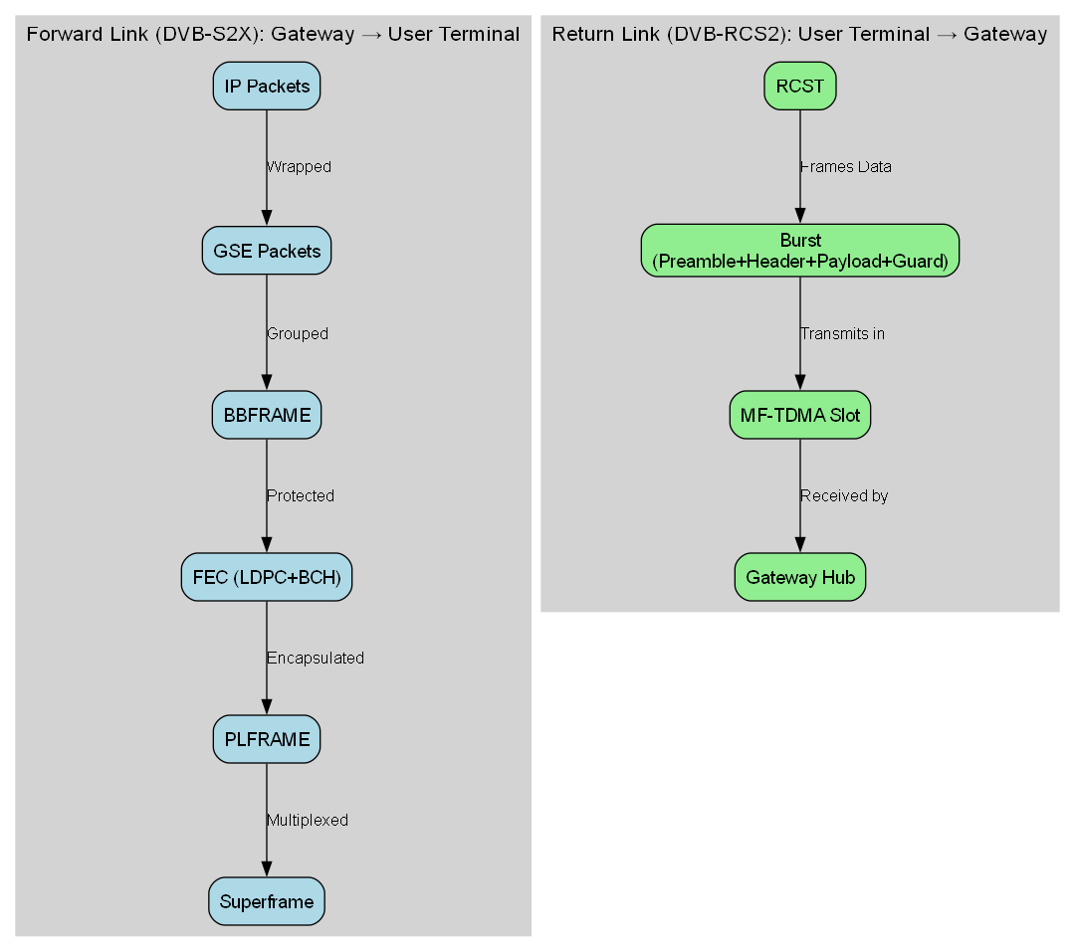
Recap : End-to-End Framing
Notes:
🎯 Purpose of the Slide:
To give a final, big-picture view of how data is framed and transmitted across both directions — from Gateway to RCST and from RCST to Gateway — covering both physical and logical layers.
🛰️ Forward Link (DVB-S2X): Gateway → User Terminal
IP Packets enter the system
Wrapped into GSE packets
Grouped into a Baseband Frame (BBFRAME)
FEC (LDPC + BCH) applied for protection
Encapsulated into PLFRAME
PLFRAMEs are time-multiplexed into Superframes
Sent over the satellite with Pilot symbols for synchronization
📡 Return Link (DVB-RCS2): User Terminal → Gateway
User Data framed with Preamble + Header + Payload + Guard
Framed as Bursts in MF-TDMA structure
Sent in scheduled time-frequency slots
MODCODs assigned based on channel quality
Received by gateway and decoded via Turbo Coding

Slide 36
DVB-S2X & RCS2
Logical And Physical Channels

Slide 37
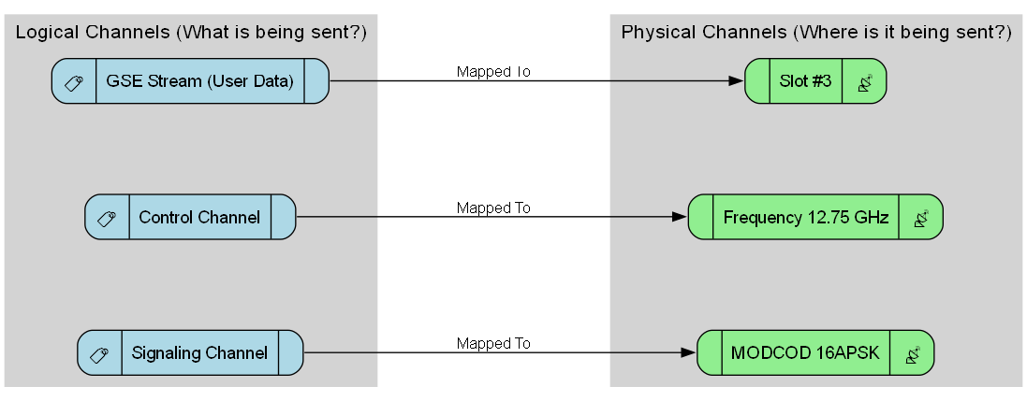
Intro To Logical & Physical Channels
Notes:
Purpose of the Slide:
Smoothly bridge from framing to how those frames are used.
Set the stage for the more detailed S2X and RCS2 channel mapping in later slides.
Give a clear, plain-language definition before diving into the DVB-specific examples.
Core Content (Bullets):
1. Why This Section Matters
After building frames (BBFRAME, PLFRAME, bursts), the system needs to decide what data goes where.
This decision is managed via logical channels and physical channels.
2. Logical Channels (Concept)
Carry the type of information (e.g., user data, control messages, management info).
Think: “What am I sending?”
3. Physical Channels (Concept)
Represent the actual resources used to send it (e.g., a time slot in MF-TDMA, a carrier frequency in S2X).
Think: “Where and how am I sending it?”
4. Key Difference:
Logical = abstract data flow type
Physical = concrete slot, frequency, or modulation settings
Both are mapped together before transmission
In DVB systems, logical channels and physical channels are tightly linked, but the mapping is not fixed forever — it’s dynamically assigned based on the system’s needs.
Logical Channels = “What am I sending?”
Examples:
GSE Stream (User Data) → carries internet traffic or video streams.
Control Channel → NCC commands, timing updates.
Signaling Channel → tells the receiver about parameters (e.g., MODCOD, beam ID).
They exist above the actual transmission and don’t care how they get sent — just that they reach the destination.
Physical Channels = “Where/how is it sent?”
Examples:
Slot #3 → in MF-TDMA, a specific time window to transmit.
Frequency 12.75 GHz → the RF carrier you’re modulating onto.
MODCOD 16APSK → the modulation + coding scheme used for robustness or speed.
They exist in the physical layer, meaning they directly relate to the actual carrier waveform over the satellite link.

Slide 38
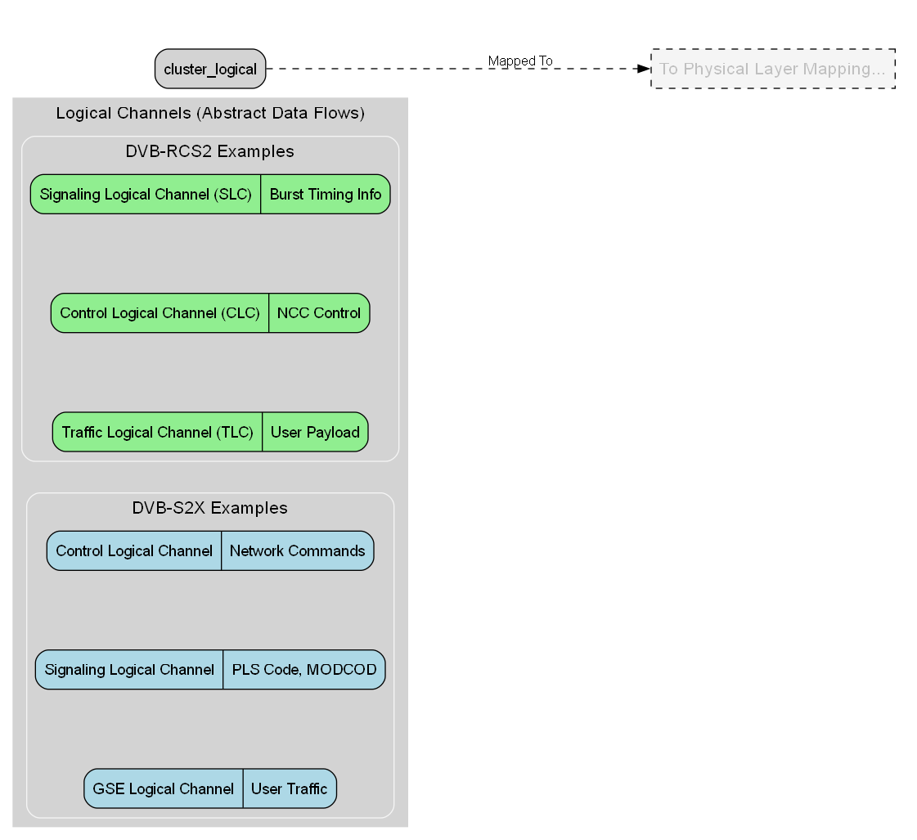
What Are Logical Channels
Definition: Logical channels are functional data flows between the MAC and physical layer, each carrying a specific type of information.
Purpose: Separate and manage different traffic types — user payload, control information, and signaling — before transmission.
DVB-S2X Examples:
  Control Logical Channel (CLC): Network management commands
  GSE Logical Channel: Encapsulated IP / MPEG-TS user traffic
  Signaling Logical Channel: PLS code, MODCOD, frame structure signaling
DVB-RCS2 Examples:
  Traffic Logical Channel (TLC): User payload in return link
  Control Logical Channel (CLC): NCC control and resource allocation
  Signaling Logical Channel (SLC): Burst timing, slot assignment info
Notes:
In DVB systems, logical channels are defined in ETSI standards (EN 302 307-2 for DVB-S2X and EN 301 545-2 for DVB-RCS2) as abstract data flows that carry specific types of information before mapping to physical transmission resources. They represent the functional classification of the transmitted information.

Slide 39
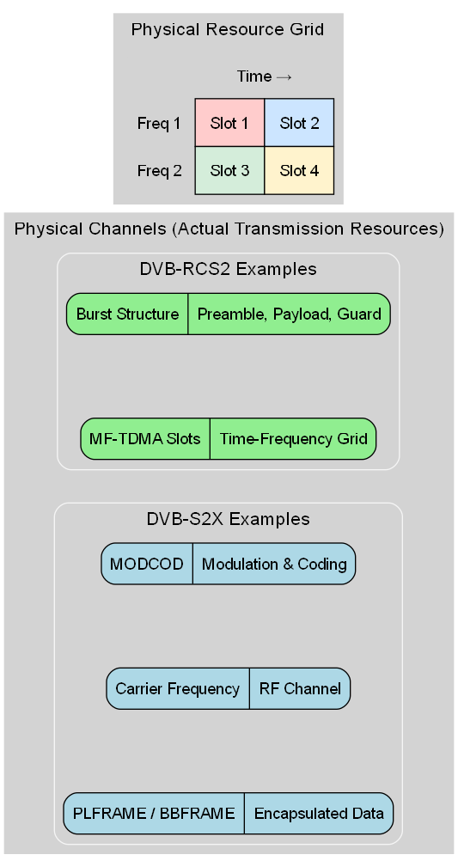
What Are Physical Channels
Definition: Physical channels are actual transmission resources in the physical layer, defined by time, frequency, and modulation/coding (MODCOD) parameters.
Purpose: Provide the medium through which logical channels are actually sent over the satellite link.
DVB-S2X Examples:
  PLFRAME / BBFRAME: Encapsulated forward link data for transmission
  Carrier Frequency Allocation: Physical RF channel assignments
  MODCOD: Defines modulation and coding rate for each PLFRAME
DVB-RCS2 Examples:
  MF-TDMA Slots: Time-frequency slots in the return link burst
  Carrier Frequencies: Allocated uplink RF channels for RCSTs
  Burst Structure Parameters: Preamble, payload, and guard time details

Slide 40
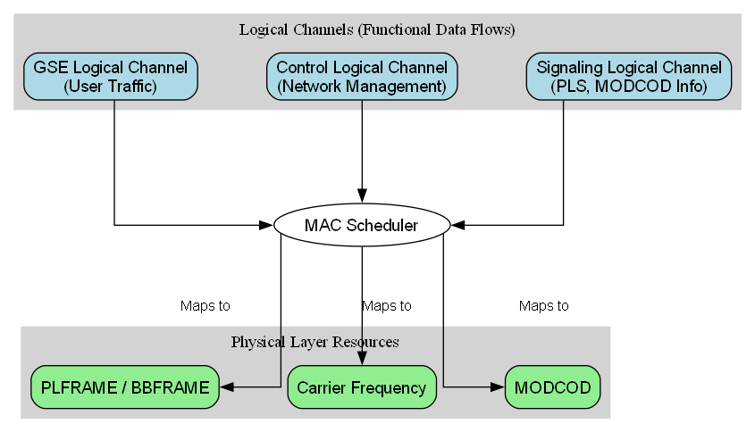
Logical Channels In DVB-S2X
Notes:
Definition:
Logical channels in DVB-S2X represent functional data flows at the MAC and upper PHY interface before mapping to physical layer resources.
Each logical channel carries a specific type of data or control information, which will be encapsulated into Baseband Frames (BBFRAMEs) and transmitted as Physical Layer Frames (PLFRAMEs).
Types:
GSE Logical Channel
Carries user traffic encapsulated in Generic Stream Encapsulation (GSE) or Transport Stream (TS) format.
Examples: IP packets, MPEG-TS video streams.
Control Logical Channel
Manages network control, resource allocation, and terminal management functions.
Exchanged between Gateway (GW) and terminals.
Signaling Logical Channel
Conveys Physical Layer Signaling (PLS) parameters such as MODCOD, pilot patterns, and frame type.
Ensures terminals can correctly demodulate and decode upcoming frames.
Mapping to Physical Layer:
MAC Scheduler maps logical channels to:
PLFRAME / BBFRAME (forward link)
Carrier frequency and MODCOD (link adaptation)
Uses Adaptive Coding and Modulation (ACM) for efficient spectrum use.

Slide 41
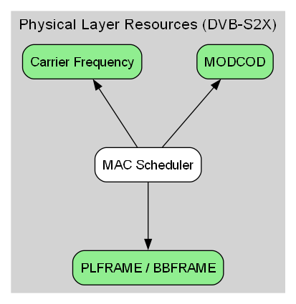
Physical Channels In DVB-S2X
Carrier Frequency
  RF channel assignment in Ku, Ka, or other bands.
  Allocated to different beams or services.
MODCOD (Modulation and Coding)
  Combines modulation type (e.g., QPSK, 8PSK, 16APSK, 64APSK) with FEC rate.
  Chosen dynamically via ACM (Adaptive Coding and Modulation).
PLFRAME / BBFRAME
  BBFRAME: Encapsulates baseband user or control data.
  PLFRAME: Adds physical layer overhead (PLHEADER, pilots) for synchronization and demodulation.
Notes:
Physical channels in DVB-S2X represent the actual transmission resources at the physical layer that carry modulated and encoded data over the satellite link. They are the “where and how” of transmission — determined by frequency, modulation, coding, and framing parameters.

Slide 42
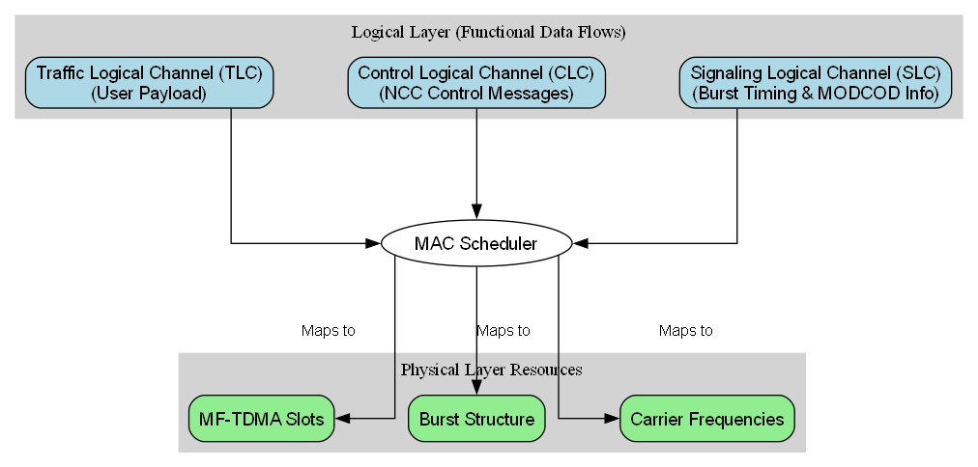
Logical Channels In DVB-RCS2
Notes:
Logical Layer (Functional Data Flows)
Traffic Logical Channel (TLC) → carries user payload (IP packets, application data).
Control Logical Channel (CLC) → carries control messages from the NCC (Network Control Centre) to RCSTs (return channel satellite terminals).
Signaling Logical Channel (SLC) → carries timing and burst profile information (like when to transmit, what waveform to use).
MAC Scheduler
Allocates MF-TDMA slots to each RCST based on demand, QoS, and control policies.
Determines carrier frequency and slot timing for each burst.
Physical Layer Resources
MF-TDMA Slots → the time–frequency resource units assigned for uplink bursts.
Burst Structure → preamble, payload, and guard time.
Carrier Frequencies → specific RF channels in the uplink band.

Slide 43
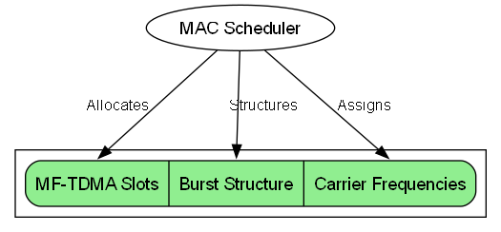
Physical Channels In DVB-RCS2
MF-TDMA Slots
  Fundamental time–frequency units in the uplink.
  Each slot is assigned to a terminal (RCST) by the MAC Scheduler.
Burst Structure
  Preamble → synchronization and identification.
  Payload → encapsulated data from TLC/CLC/SLC.
  Guard Time → avoids interference between bursts.
Carrier Frequencies
  RF channels within the uplink band.
  Used to separate parallel MF-TDMA frames or carriers.
MAC Scheduler allocates MF-TDMA slots in time and on specific carrier frequencies.
Each burst is structured with preamble, payload, and guard time.
This ensures precise synchronization and efficient spectrum usage.

Slide 44
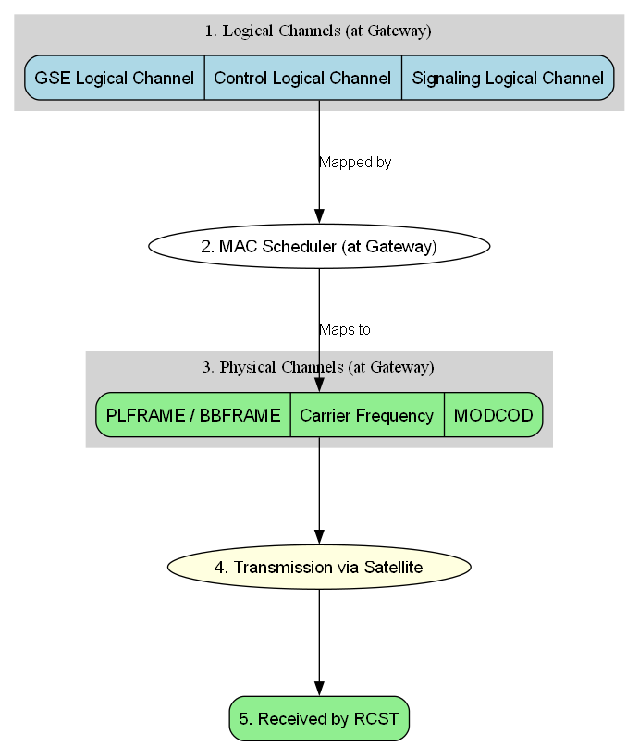
Channel Mapping: Gateway → RCST
Application / Network Layer
  Data originates from Gateway IP packets (Internet, video, VoIP, etc.).
Logical Channels (DVB-S2X)
  GSE Logical Channel → encapsulates IP/MPEG-TS user traffic.
  Control Logical Channel → network management messages.
  Signaling Logical Channel → PLS, MODCOD information.
MAC Scheduler (Gateway)
  Maps logical channels into appropriate physical layer resources based on QoS, priority, and capacity.
Physical Channels (DVB-S2X)
  PLFRAME / BBFRAME → encapsulated payload.
  Carrier Frequency → assigned RF channel.
  MODCOD → chosen modulation & coding scheme.
Transmission via Satellite
  Forward link over the satellite downlink to the RCST.

Slide 45
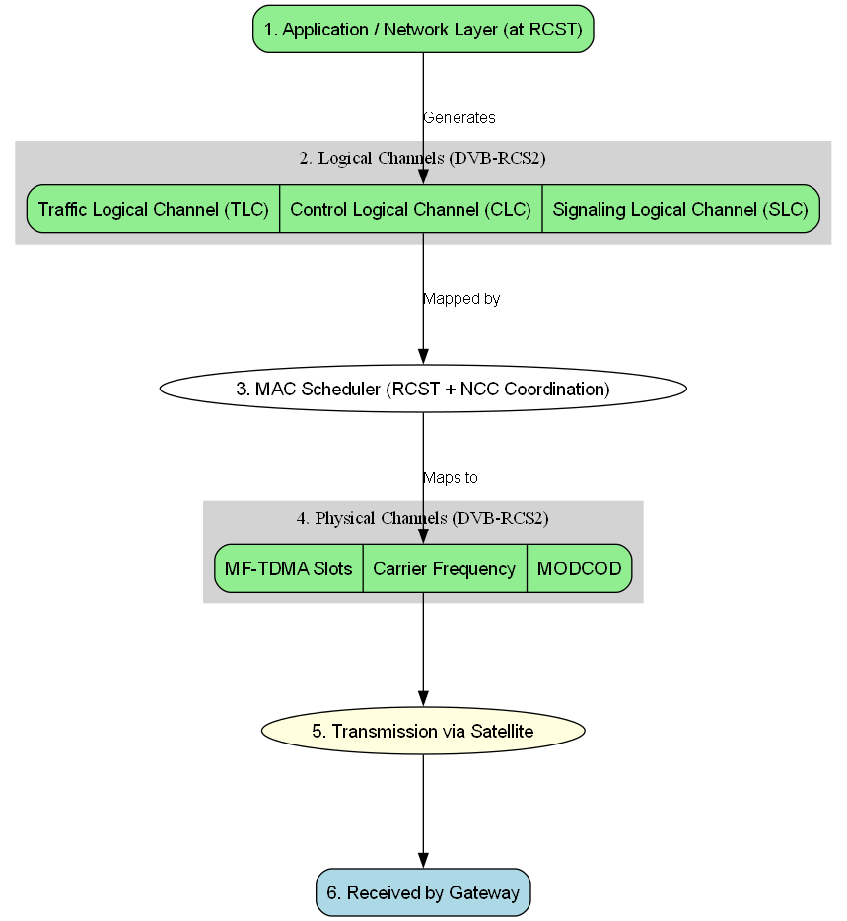
Channel Mapping: RCST → Gateway
Application / Network Layer (RCST)
  User-generated data (web requests, VoIP, telemetry, etc.) originates from the RCST.
Logical Channels (DVB-RCS2)
  Traffic Logical Channel (TLC) → user payload data.
  Control Logical Channel (CLC) → network control commands for the NCC.
  Signaling Logical Channel (SLC) → burst timing, slot requests.
MAC Scheduler (RCST + NCC Coordination)
  Uses MF-TDMA slot assignments received from NCC.
  Maps logical channels into the correct time slots, frequencies, and burst parameters.
Physical Channels (DVB-RCS2)
  MF-TDMA Slots → time–frequency resource blocks for bursts.
  Carrier Frequency → uplink RF channel.
  MODCOD → modulation & coding scheme for burst.
Transmission via Satellite
  Return link uplink from RCST to satellite, then downlink to Gateway.

Slide 46
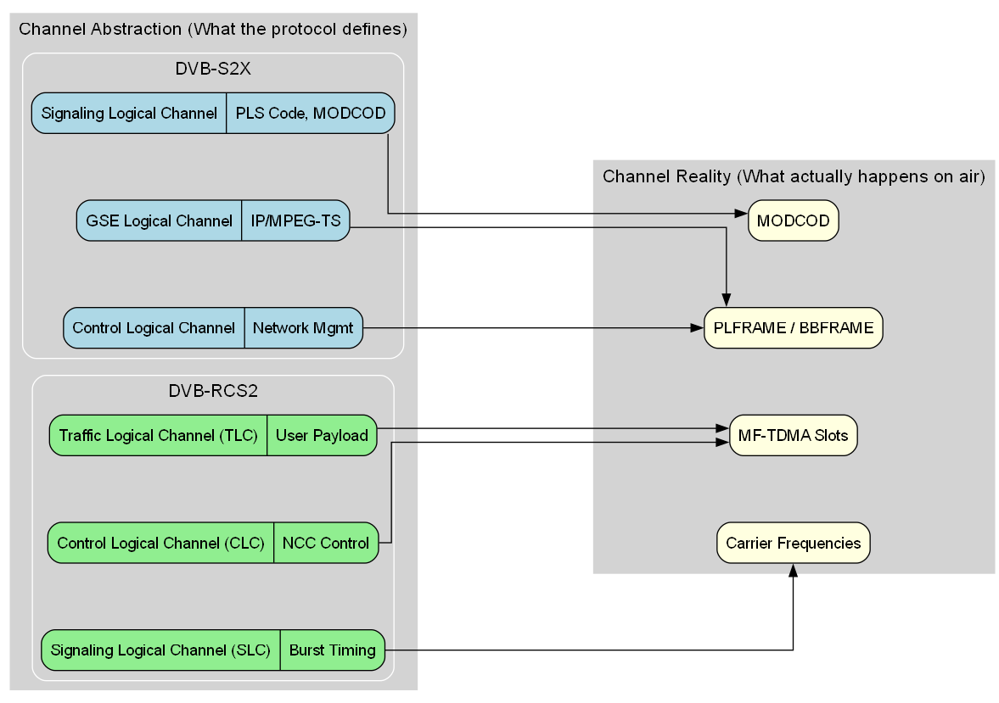
Recap: Channel Abstraction vs Reality

Slide 47
NTN (Non-Terrestrial Network) NR (New Radio)
Implementing NTN NR On Top Of DVB L1

Slide 48
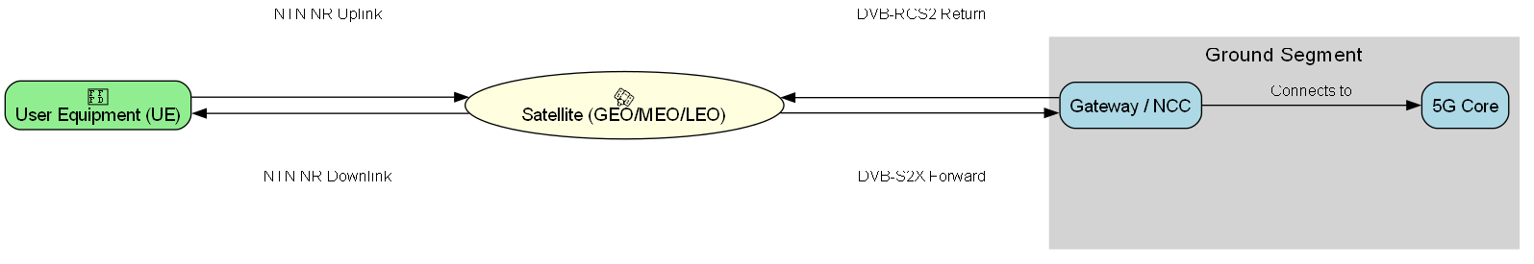
What is NTN NR
Definition
  NTN NR is the 3GPP adaptation of 5G New Radio (NR) technology for non-terrestrial platforms such as satellites and high-altitude platforms (HAPS).
  It extends NR to operate over GEO, MEO, and LEO satellites.
Purpose
  Integrate satellite access into the global 5G ecosystem.
  Support both direct-to-device (UE ↔ Satellite) and backhaul scenarios.
  Enable seamless mobility between terrestrial and non-terrestrial coverage.
Key Challenges
  Long Round-Trip Time (RTT) → Impacts HARQ, timing advance, buffer sizes.
  Doppler Shift (especially in LEO) → Requires frequency pre-compensation.
  Variable Link Quality → Requires adaptive modulation/coding & beam handovers.
Relevance to DVB
  DVB-S2X and DVB-RCS2 provide the L1 PHY framing over which NTN NR’s higher layers could operate.The question is how to map NR’s protocol stack into DVB’s PHY/MAC framing while preserving QoS and timing requirements.

Slide 49
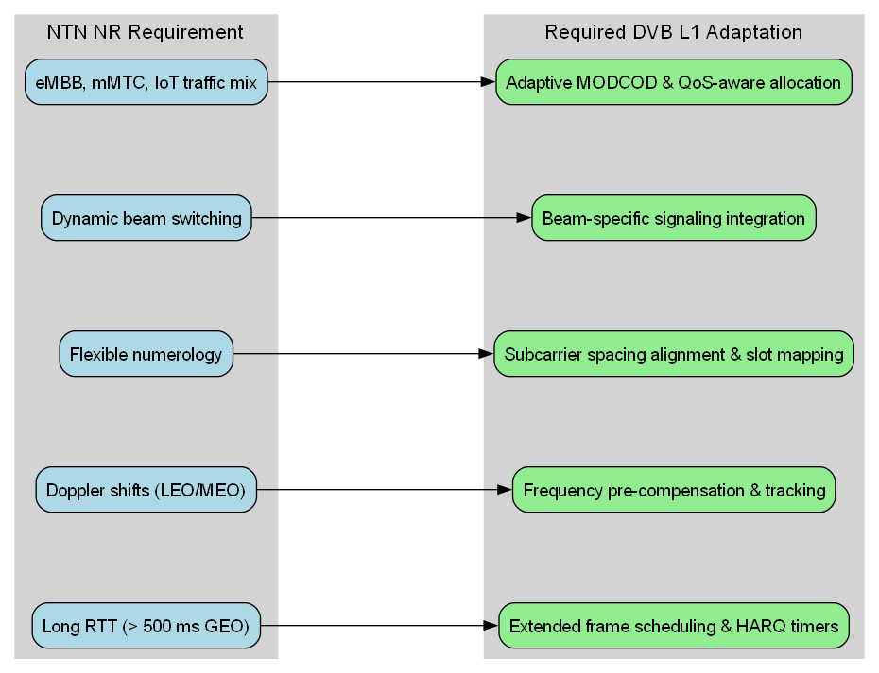
Required Adaptations for NTN NR over DVB L1
Notes:
1. Long RTT (> 500 ms GEO) → Extended Frame Scheduling & HARQ Timers
Why: GEO satellites have a huge round-trip time compared to terrestrial 5G (500–600 ms vs <10 ms).
Impact on DVB L1: Frame scheduling windows must be extended, and HARQ (Hybrid Automatic Repeat Request) timers in the MAC/PHY must be adapted so that retransmissions don’t time out too early.
2. Doppler Shifts (LEO/MEO) → Frequency Pre-Compensation & Tracking
Why: LEO/MEO satellites move relative to the user, causing Doppler frequency shifts (several kHz to MHz).
Impact on DVB L1: The carrier frequency in the physical layer must be pre-compensated at the gateway, and receivers must track these changes dynamically to stay locked to the signal.
3. Flexible Numerology → Subcarrier Spacing Alignment & Slot Mapping
Why: 5G NR supports multiple subcarrier spacings (15, 30, 60 kHz, etc.) to adapt latency and capacity. DVB normally uses fixed symbol rates and framing structures.
Impact on DVB L1: DVB’s slot allocation must be re-aligned so that NR’s OFDM numerology fits inside DVB’s framing (PLFRAME/BBFRAME) without breaking timing relationships.
4. Dynamic Beam Switching → Beam-Specific Signaling Integration
Why: NTN NR allows fast beam handovers to follow moving satellites or shifting coverage areas.
Impact on DVB L1: Signaling channels in DVB must carry beam-change information quickly enough to support NR’s mobility requirements without dropping the link.
5. Mixed Services (eMBB, mMTC, IoT) → Adaptive MODCOD & QoS-Aware Allocation
Why: NTN NR has to carry multiple service types — high-throughput broadband (eMBB), massive IoT (mMTC), and ultra-reliable low-latency control (URLLC/mMTC).
Impact on DVB L1: MODCOD (modulation and coding) must adapt per-service, and the scheduler should assign resources based on QoS priorities, not just raw throughput.

Slide 50
Thankyou

